Slide 1
Post TAVI PCI for Inferior Infarction, The challenge

Slide 2
Personal History:
60 year / male.
Risk factors:
-DM / Type II.
- HTN .
- Smoker , obese
- PCI to proximal LAD 2014 , TAVI 2015

Slide 3
Complaint :
Complain : Exertional chest pain
CCU admission
Diagnosed : NSTEMI ,
Labs ( Trop I +ve , creatinine 1.7)
For coronary angiography and PCI .

Slide 4
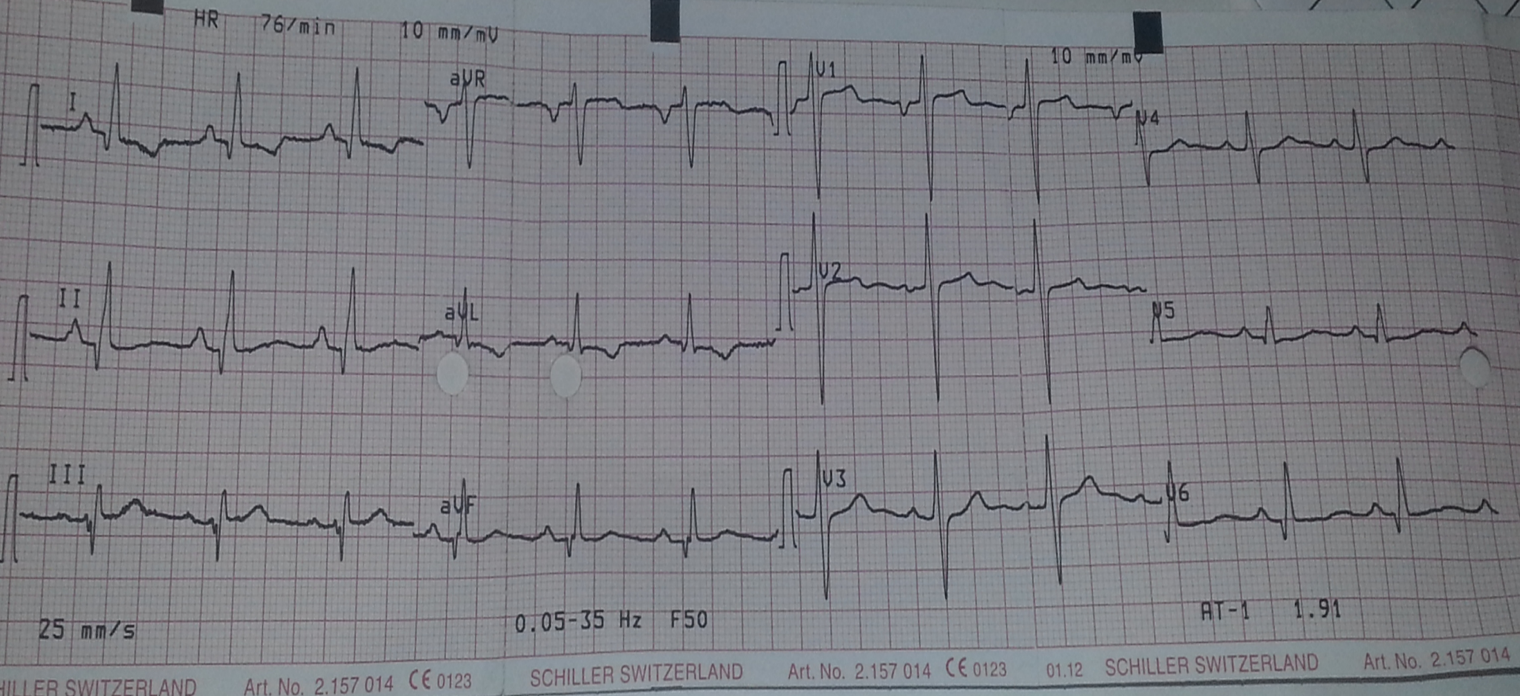
ECG & Echo:
EF = 55 % , SWMA ( infero-lateral segments )
LV : 48 X 30 mm

Slide 5
Tips and Tricks
Perform aortography to identify the coronary take-off.
Cannulate the coronary ostia through the middle of the valve frame cell at the level of the coronary takeoff. If there is difficulty with the frame cell directly coaxial to the ostium, use another cell. Avoid cannulation of the ostia from below the coronary takeoff.
Always remove the guide catheter over a wire.
Disengage the guide catheter from ostium, then withdraw through the frame cell. If there is difficulty removing the guide catheter from the ostium, use a balloon to disengage prior to pulling.

Slide 6
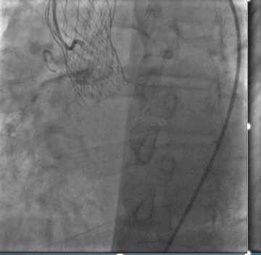
TryiTrying to Cannulate the Right Coronary artery

Slide 7
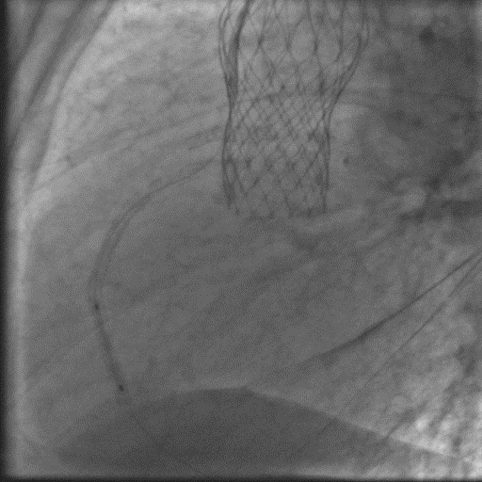
Wiring the RCA and Anchoring to stabilize the guiding

Slide 8
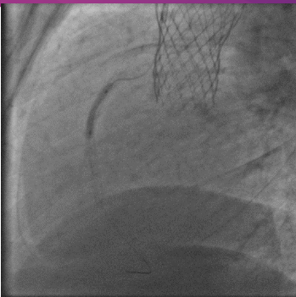
Pre-dilatation

Slide 9
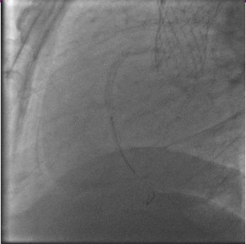
Stenting of the RCA

Slide 10
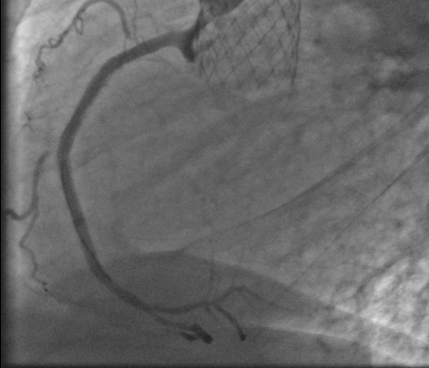
Final Result

