Slide 1
Ruptured pseudoaneurysm of the mitral-aortic intervalvular fibrosa as a rare complication post TAVR

Slide 2
No Disclosure

Slide 3
Introduction
Pseudoaneurysm of the mitral-aortic intervalvular fibrosa (P-MAIVF) is a rare but potentially fatal complication of infective endocarditis and post aortic valve surgery.
We report a case of ruptured (P-MAIVF) post transcatheter aortic valve replacement (TAVR) with fistula formation.

Slide 4
Clinical data
A 76-year-old male with long history of
Hypertension
Type II diabetic mellitus
End stage renal disease
Peripheral vascular disease with amputated leg
Coronary artery bypass grafting 15 years earlier.
In 2018 he underwent a successful TAVR with unremarkable early follow up
A systolic murmur over apex was noted one year after TAVAR in his regular follow up

Slide 5
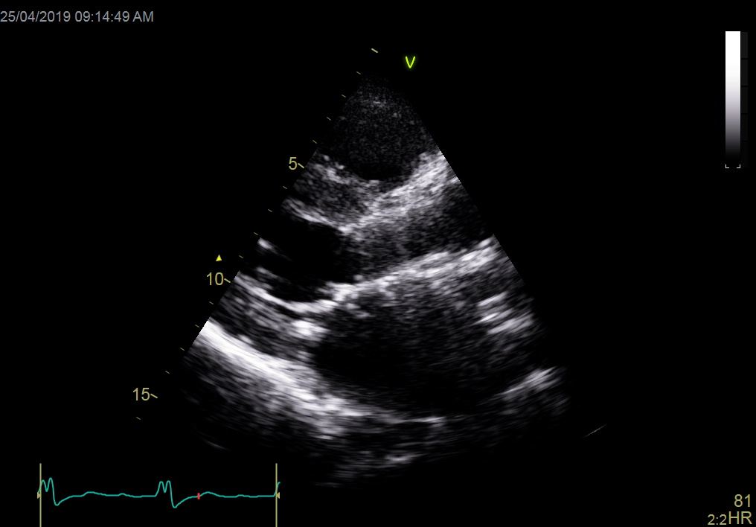
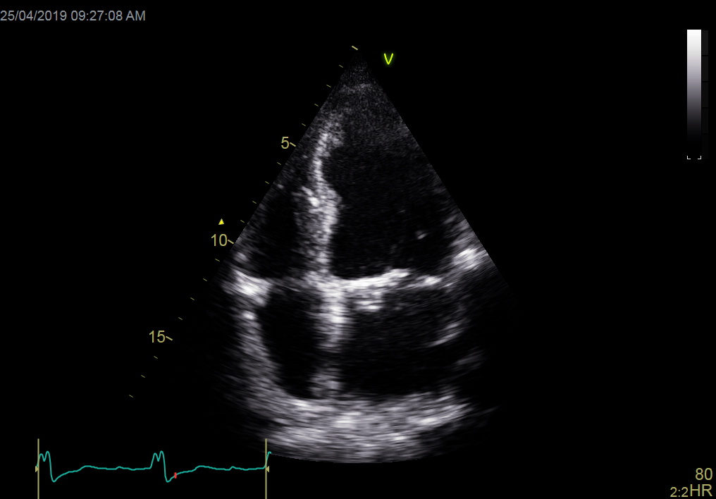
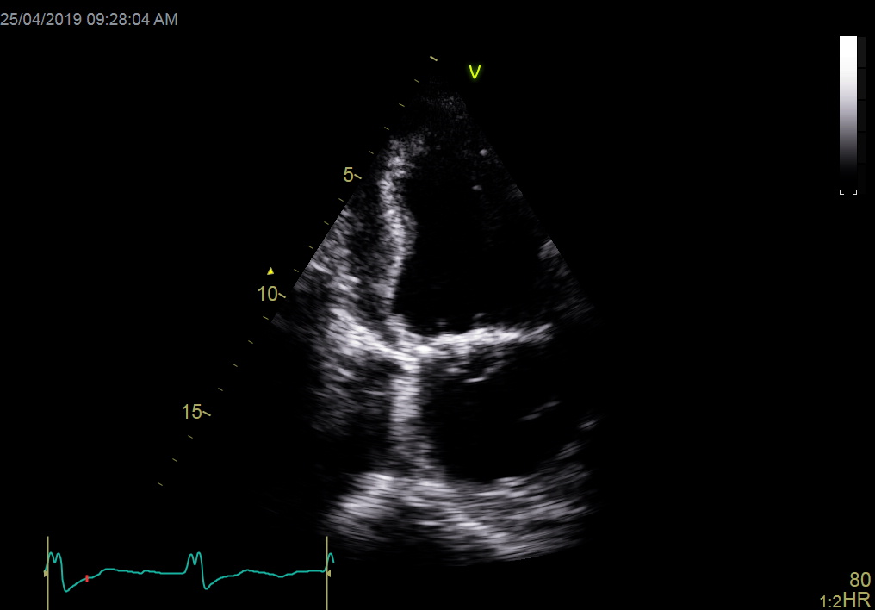
Transthoracic echocardiography ( TTE)
Transthoracic echocardiography showed
A cystic mass attached to the atrial surface of the anterior mitral leaflet

Slide 6
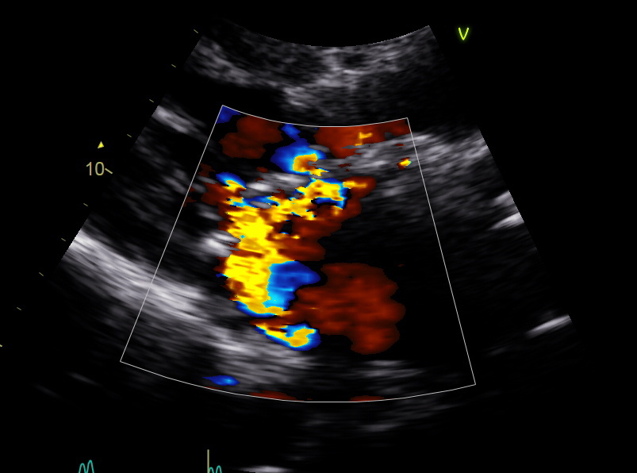
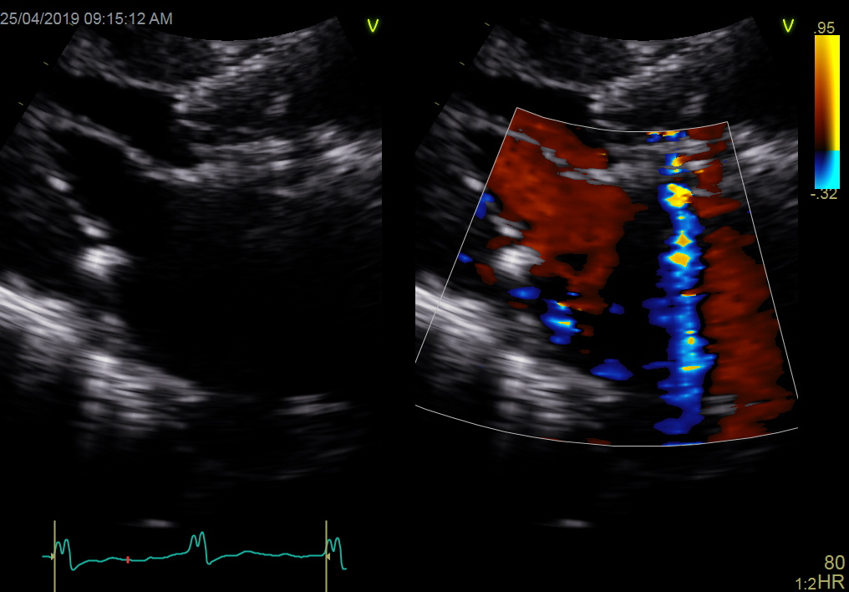
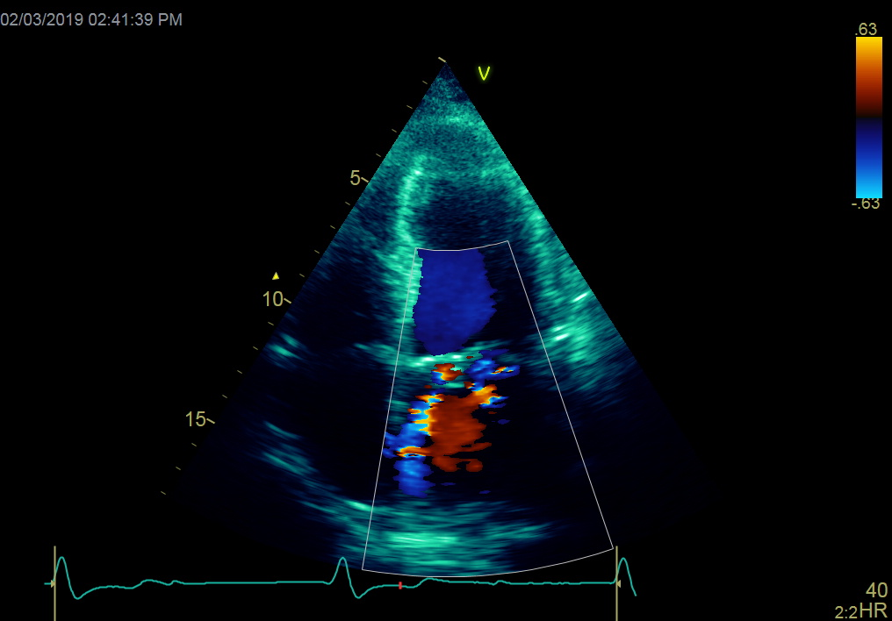
Transthoracic echocardiography ( TTE)
Two jets of mitral incompetence, one central jet ( yellow arrow) and the second jet through the basal portion of AML (red arrow) with raise possibility of leaflet perforation

Slide 7
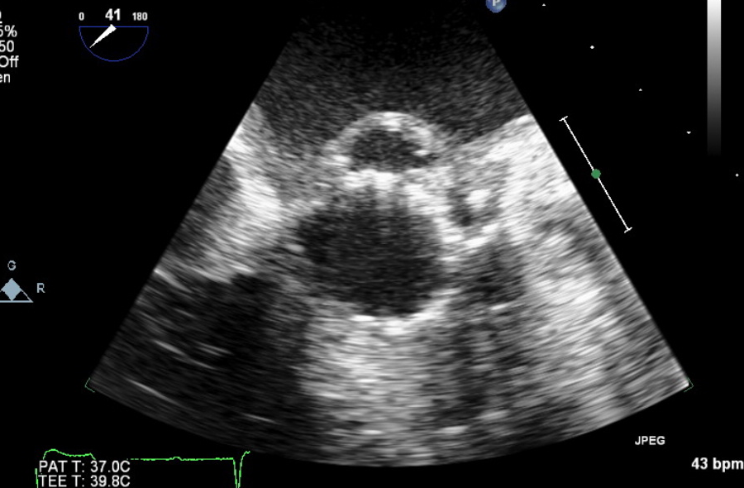
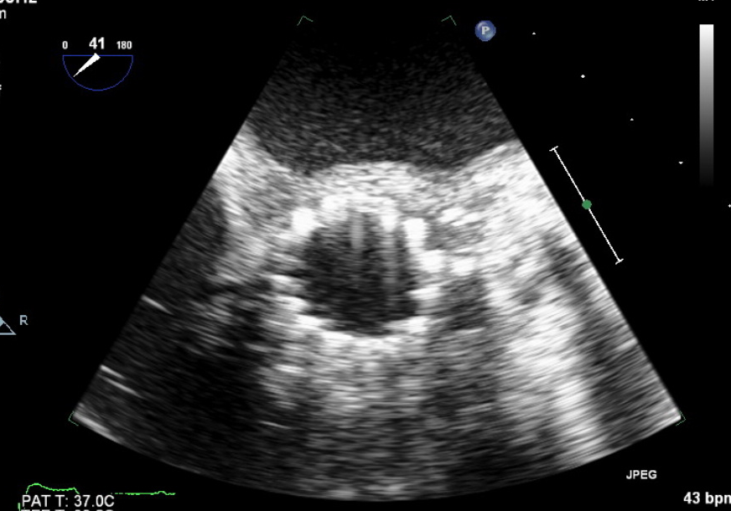
Transesophageal echocardiography (TEE)
TEE revealed a pulsatile cystic cavity (measuring 8x 27 mm) with systolic expansion (yellow arrow) and diastolic emptying (yellow red).

Slide 8
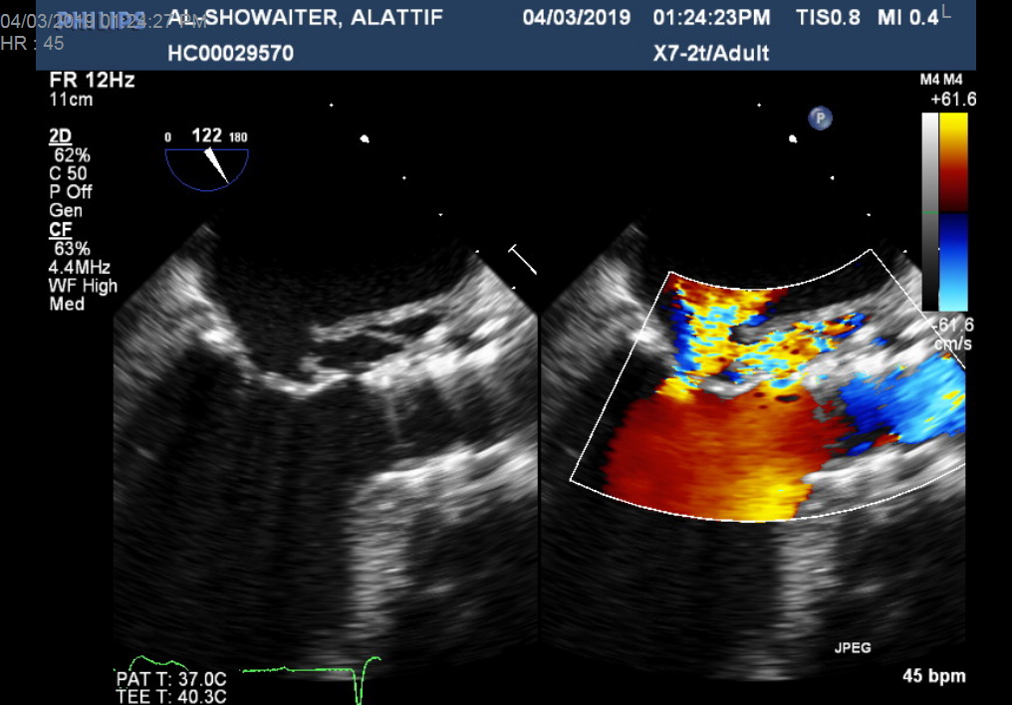
The cavity was filling from the LV outflow tract (yellow arrow)
Flow was detected (red arrow) from this cavity into the LA suggestive of rupture and fistula formation
LA
LA
LV
LV

Slide 9
Pseudoaneurysm of the mitral-aortic intervalvular fibrosa
Picture was suggestive of pseudoaneurysm of the mitral-aortic intervalvular fibrosa especially there is no fever and the laboratory workup was unremarkable with normal leucocytic count and 3 separate sets of blood cultures were negative for endocarditis.
Surgical correction was denied by the patient and surgical team due to other comorbidity . After which, he was kept on conservative measures with anti-ischemic, anti-failure medication and prophylaxis for endocarditis

Slide 10
Conclusion
The natural history of P-MAIVF is unclear, because in most cases surgical correction has been performed early to prevent P-MAIVF rupture.
We report a case of ruptured P-MAIVF with fistula to left atrium which was treated without surgical intervention
To our knowledge this a rare case of P-MAIVF reported post TAVR, and despite that the P-MAIVF was complicated by rupture and fistula formation. The patient was maintained hemodynamically stable under conservative management

