Slide 1
Transcatheter edge-to-edge tricuspid repair for recurrent tricuspid regurgitation after left ventricular assist device and tricuspid ring implantation

Slide 2
Introduction
Up to 50% of the patients undergoing LVAD implantation have moderate or severe tricuspid regurgitation (TR)
The role of concomitant surgical treatment of TR is still matter of debate, especially in the setting of right ventricle dysfunction
Transcatheter treatment for functional tricuspid valve regurgitation has been recently reported with promising short and mid-term results
LVAD patients with recurrent or primarily not addressed tricuspid regurgitation may benefit from this technique

Slide 3
Medical History
59 years old female patient
Previous breast carcinoma surgically and medically treated in 2010
Post-chemiotherapy dilative cardiomyopathy medically treated
Persistent atrial fibrillation (QRS < 110 ms)
Diabetes mellitus (oral therapy)
Previous smoker
Arterial hypertension

Slide 4
Case Presentation
March 2019: acute HF and indication to LVAD therapy
HeartMATE III implantation and tricuspid repair with a #32 mm Medtronic Contour 3D ring implantation as bridge to decision
Temporary RVAD support (11 days)
47 POD: discharge for rehabilitation in good clinical conditions
70 POD: readmission for retrosternal hematoma with compression of the outflow graft surgically treated
Postoperative course: prolonged need of inotropic intravenous support

Slide 5
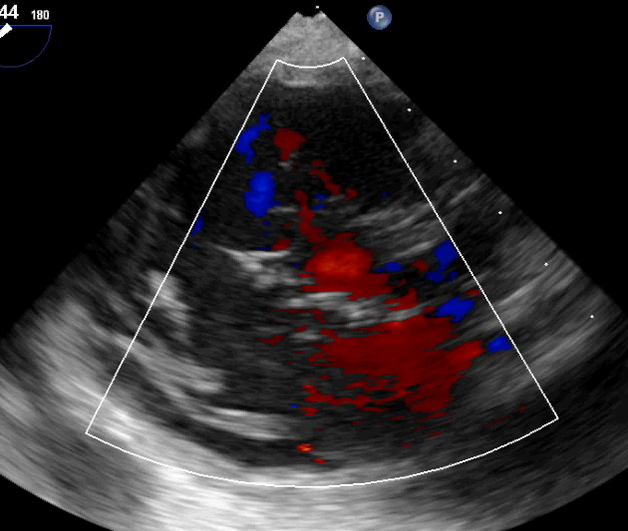
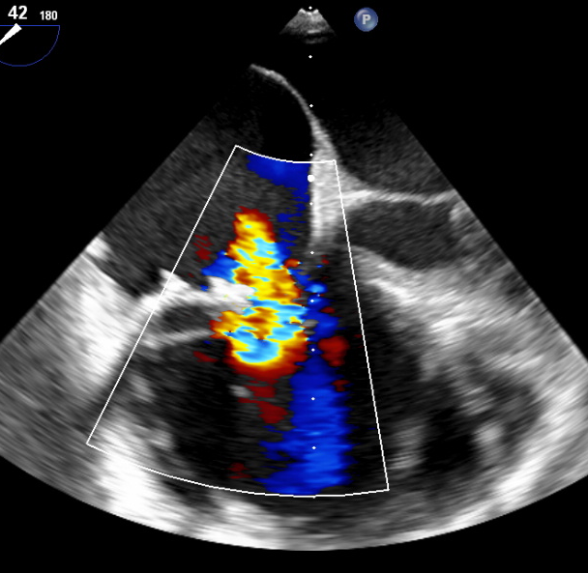
Echo findings
Torrential Tricuspid Regurgitation
Central JET + partial ring detachment
EROA: 1.4 cm²
Annulus 32 mm (ring)
Coaptation gap 4 mm
Coptation depth 5 mm
TAPSE: 5mm

Slide 6
Treatment Options
INTERMARCS Class 3
EuroSCORE II 25%, STS Mortality 5% (mitral repair)
Surgical REDO tricuspid repair and replacement
X
High Surgical risk and third sternotomy in 90 days
X
Tricuspid valve in ring
Partial Tricuspid Ring detachment
Transcatheter annular procedure
X
Previous surgical ring in place
X
CAVI- Tricento
Unknown role on hemodynamics
Feasibile and positively judged from
Heart-team
Leaflet repair: edge-to-edge

Slide 7
EDGE TO EDGE ELIGIBILITY CRITERIA: OUR APPROACH
Parameters | Yes | No
Severe symptomatic TR | ✔
Coaptation gap < 7 mm | ✔
Effective regurgitant orifice area < 1.5 cm² | ✔
Coaptation depth < 1 cm | ✔
Central or antero-septal jet | ✔
Not Restricted motion of leaflet | ✔
No Lead trough the valve | ✔
Good Echo quality | ✔

Slide 8
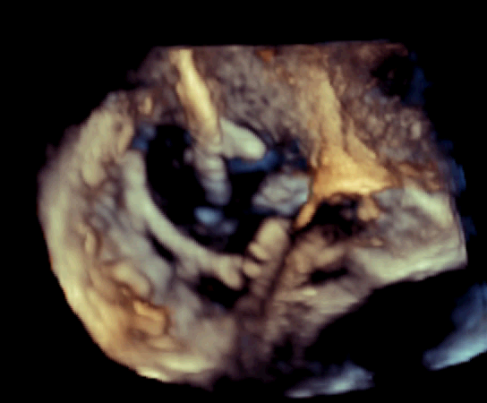
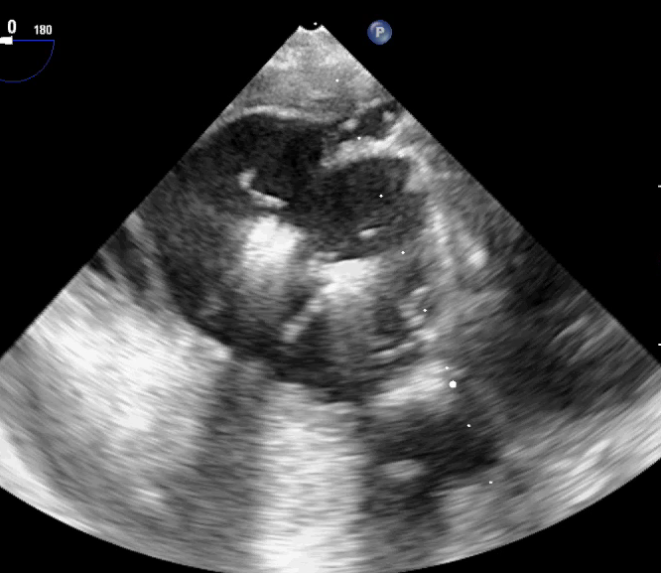
INTRAOPERATIVE FINDINGS
First XTRclip between the anterior and septal leaflet
Second XTRclip between the posterior and septal leaflet

Slide 9
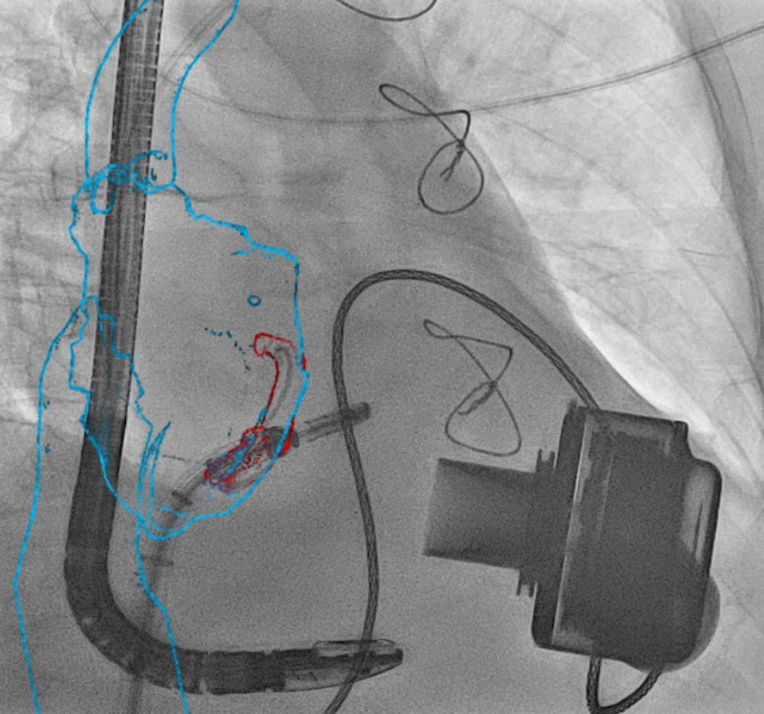
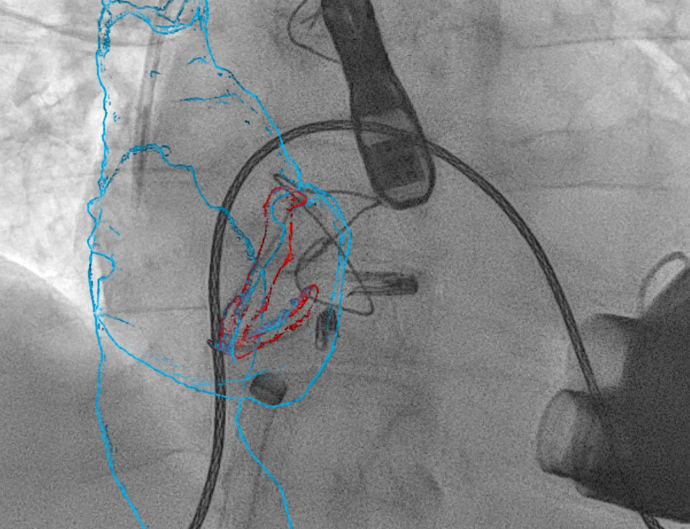
FUSION IMAGING
Semi-manual segmentation and 3D reconstruction of right atrium, inferior and superior vena cava and tricuspid ring.
Intra-procedural guidance
Final Result

Slide 10
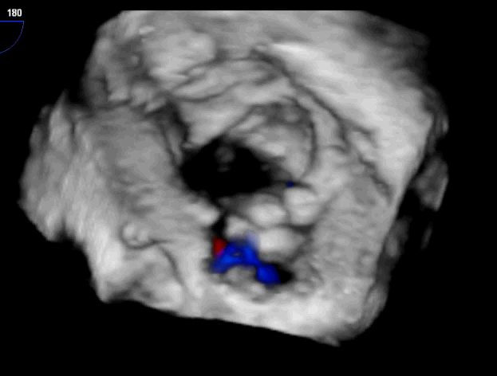
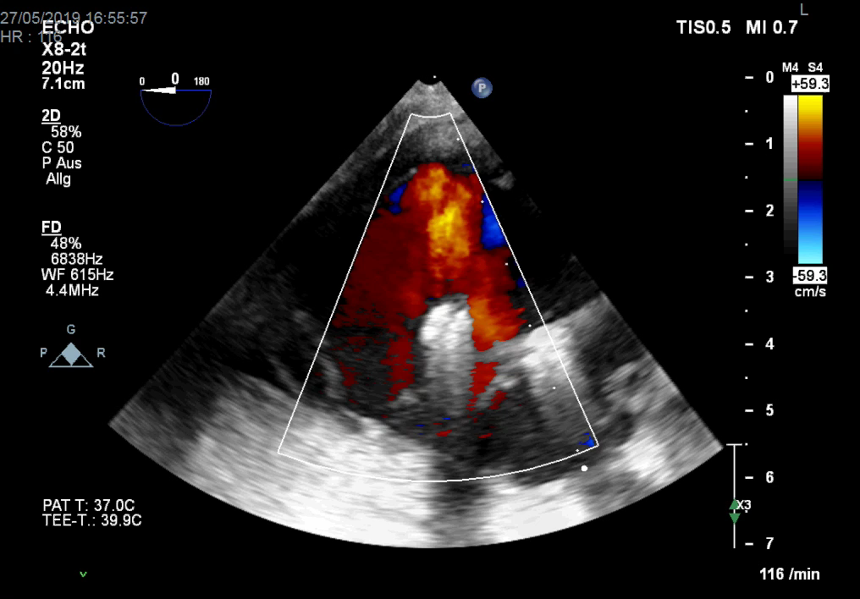
POSTOPERATIVE RESULT
Reduction of TR of 1 degree
EROA: 0.7 cm² (⬇50%)
Tricuspid valve gradient: 2 mmHg
Antero-posterior Jet
According the severe reduced right ventricle function further reduction were not attempted

Slide 11
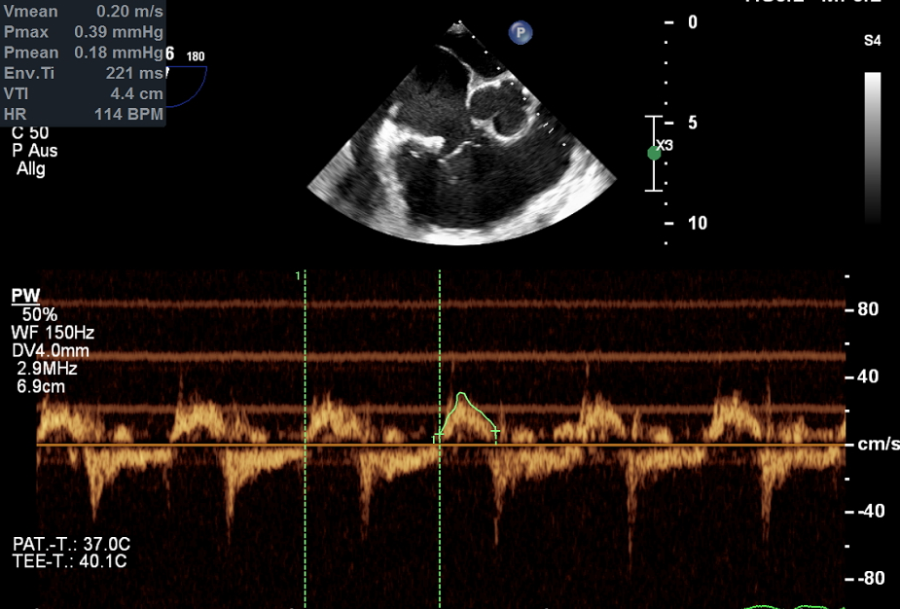
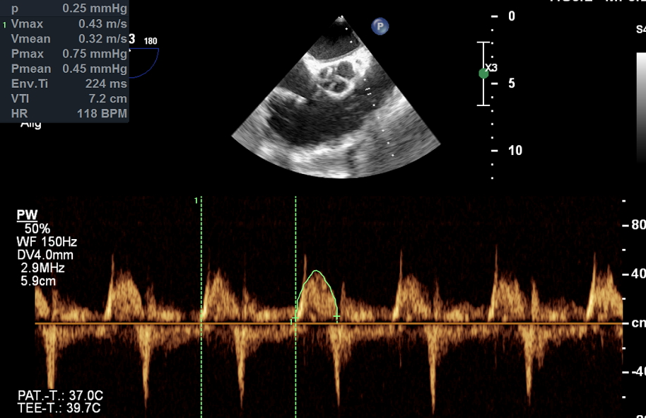
IMPROVEMENT OF RIGHT VENTRICLE OUTPUT
Preoperative
Post-clip
Right Ventricle cardiac index= 1.9 l/min
Post-clipping: Right Ventricle cardiac index= 3.4 l/min
Right Ventricle Output=
π * (right ventricular outflow tract diameter / 2)²) * VTI-RVOT * heart rate

Slide 12
DISCUSSION
Tricuspid regurgitation in patient with LVAD has a significant impact on prognosis and quality of life
The consequent effects of TR on liver and renal function could negatively impact on the upcoming heart transplantation
In this cohort of patients transcatheter treatment with Mitraclip has potential advantages:
Avoid chest re-entry in the setting of a bridge to transplantation or multiple previous surgeries
Possibility to evaluate after each clip the amount of reduction of TR deciding when to stop according grade of right heart dysfunction
Bailout strategy when other transcatheter strategy are contra-indicated

Slide 13
CONCLUSION
In this patient with previous implanted LVAD the procedure was feasible and resulted in TR reduction TR 50% of baseline EROA despite a dehiscent ring in place
No early adverse events reported and no acute changes in hemodynamic balance
Fusion imaging was an useful and adjunctive tool to guide the procedure
The procedure represents a promising non surgical bridge strategy
Follow-up data and impact on prognosis will be matter of further analysis

