Slide 1
MitraClip for flail mitral posterior leaflet and systolic anterior motion of anterior leaflet in patient with hypertrophic obstructive hypertrophic cardiomyopathy.

Slide 2
Speaker‘s name :
☑ I do not have any potential conflict of interest

Slide 3
Case presentation: 70 year-old male
He complained of NYHA class II dyspnea for 3 months.
Although there had been left-ventricular outflow tract (LVOT) gradient of 50 mmHg from systolic anterior movement (SAM) of mitral anterior leaflet (AML) detected 6 years ago, it remained resolved with medical therapy.
Newly developed severe mitral regurgitation (MR) due to flail P2 leaflet was found.
We planed MitraClip procedure to fix the mitral valve.

Slide 4
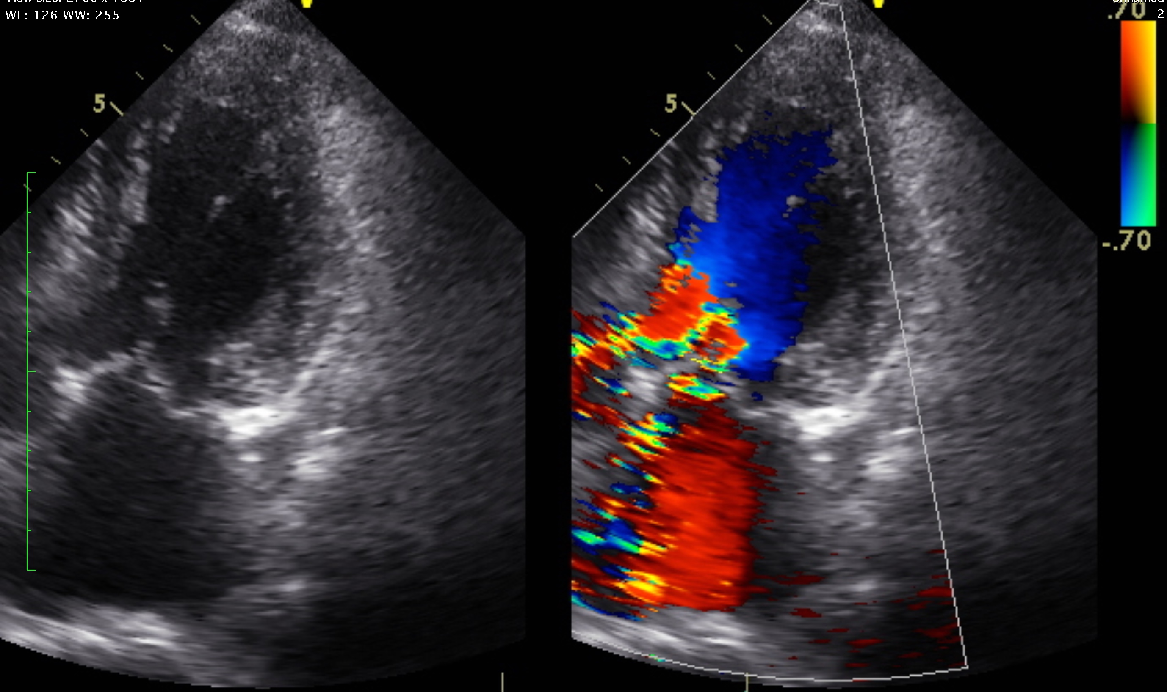
Pre procedural TTE: 3ch view
TTE:
LVEF 74%
LVDd/s 54/31mm
LV IVS/PW 15/14mm
MR severe due to P2 flail
AS none, AR mild
LVOT Vp 1.43m/s
Although there was SAM of AML,
LVOT obstruction was not found.

Slide 5
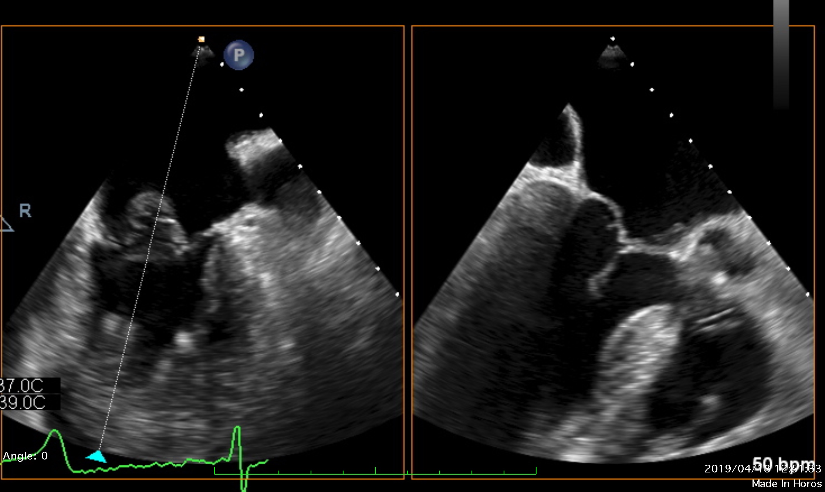
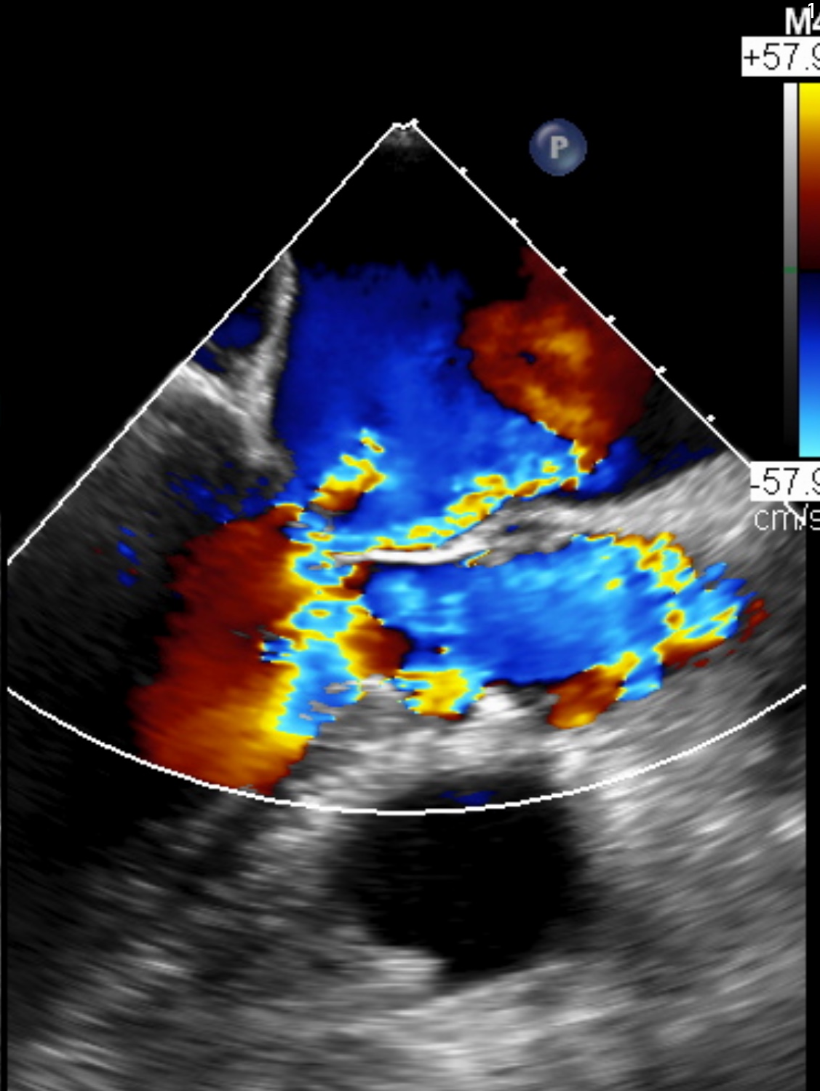
TEE: bi-commissure and LVOT view
P2 : Flail with tore chordae
A2 : moving anterior due to SAM
Notes:
P2 : Flail with tore chordae

Slide 6
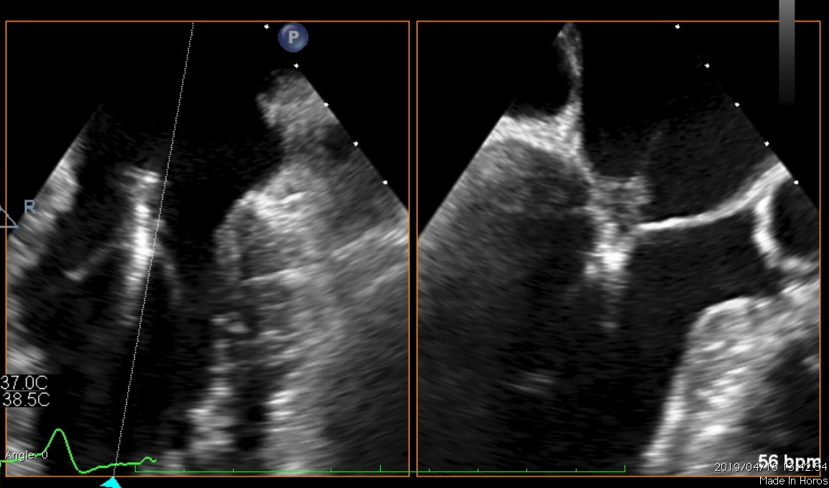
TEE: Grasping the leaflet
We deploy a clip at the centre of A2/P2
where the chordae tore
Notes:
P2 : Flail with tore chordae

Slide 7
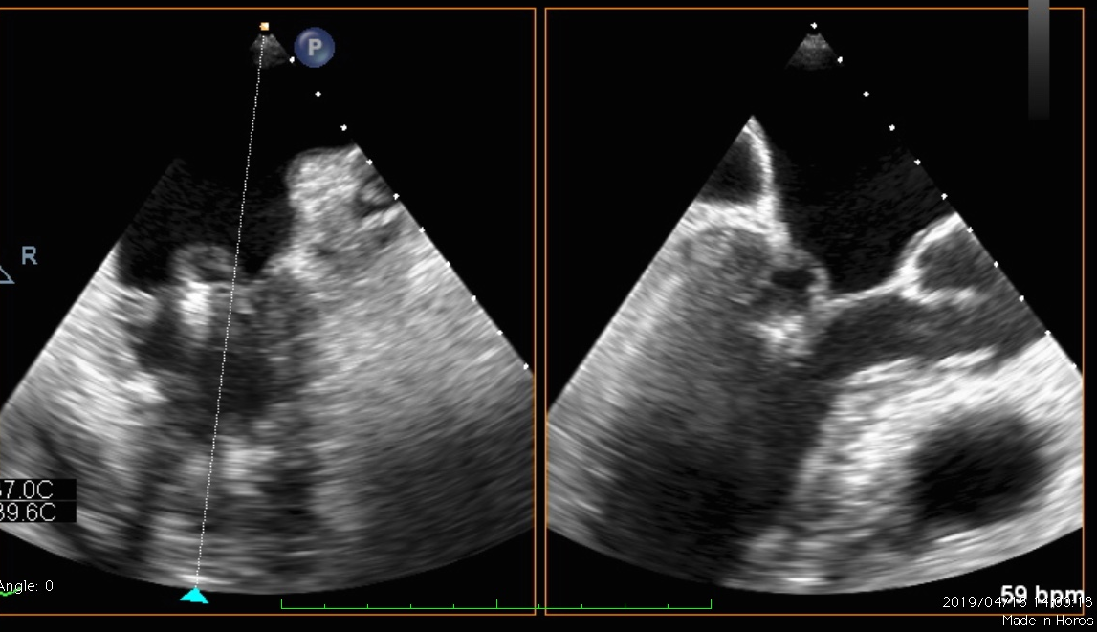
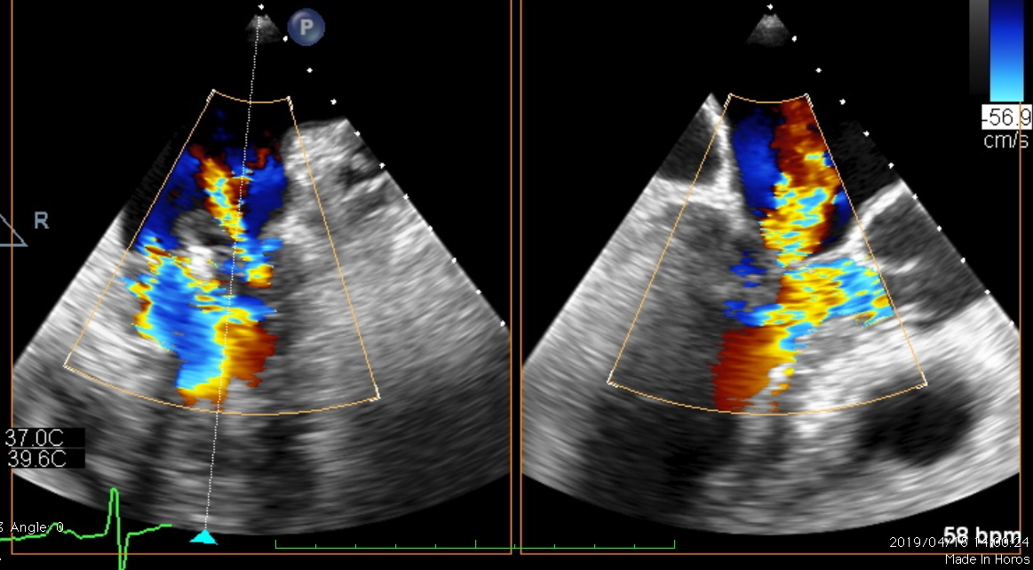
TEE: Post deployment of the Clip
Mild residual MR at lateral side.
No SAM and LVOT obstruction.
V wave of left atrium pressure
24 mmHg → 18 mmHg.
MV mean PG=4.5 mmHg.
Notes:
P2 : Flail with tore chordae

Slide 8
Post procedural course
Post procedural course was uneventful.
His dyspnea resolved promptly after the procedure.

Slide 9
MitraClip for SAM
Surgical mitral valve repair with ring annuloplasty in patients with HOCM might result in worsening SAM.
In case SAM occurred during surgical mitral valve repair, adding the edge-to-edge suture was simple and effectively technique. (Ann Thorac Surg 2005;79:471–4)
Although Diverting MitraClip system to treating symptomatic LVOT obstruction from SAM with good outcomes, It remains off-label use. (EuroIntervention 2015;11:942-947)

Slide 10
Conclusion
We report a case that showed the feasibility of the MitraClip system to fix not only degenerative MR but also SAM caused by HOCM.

