Slide 1

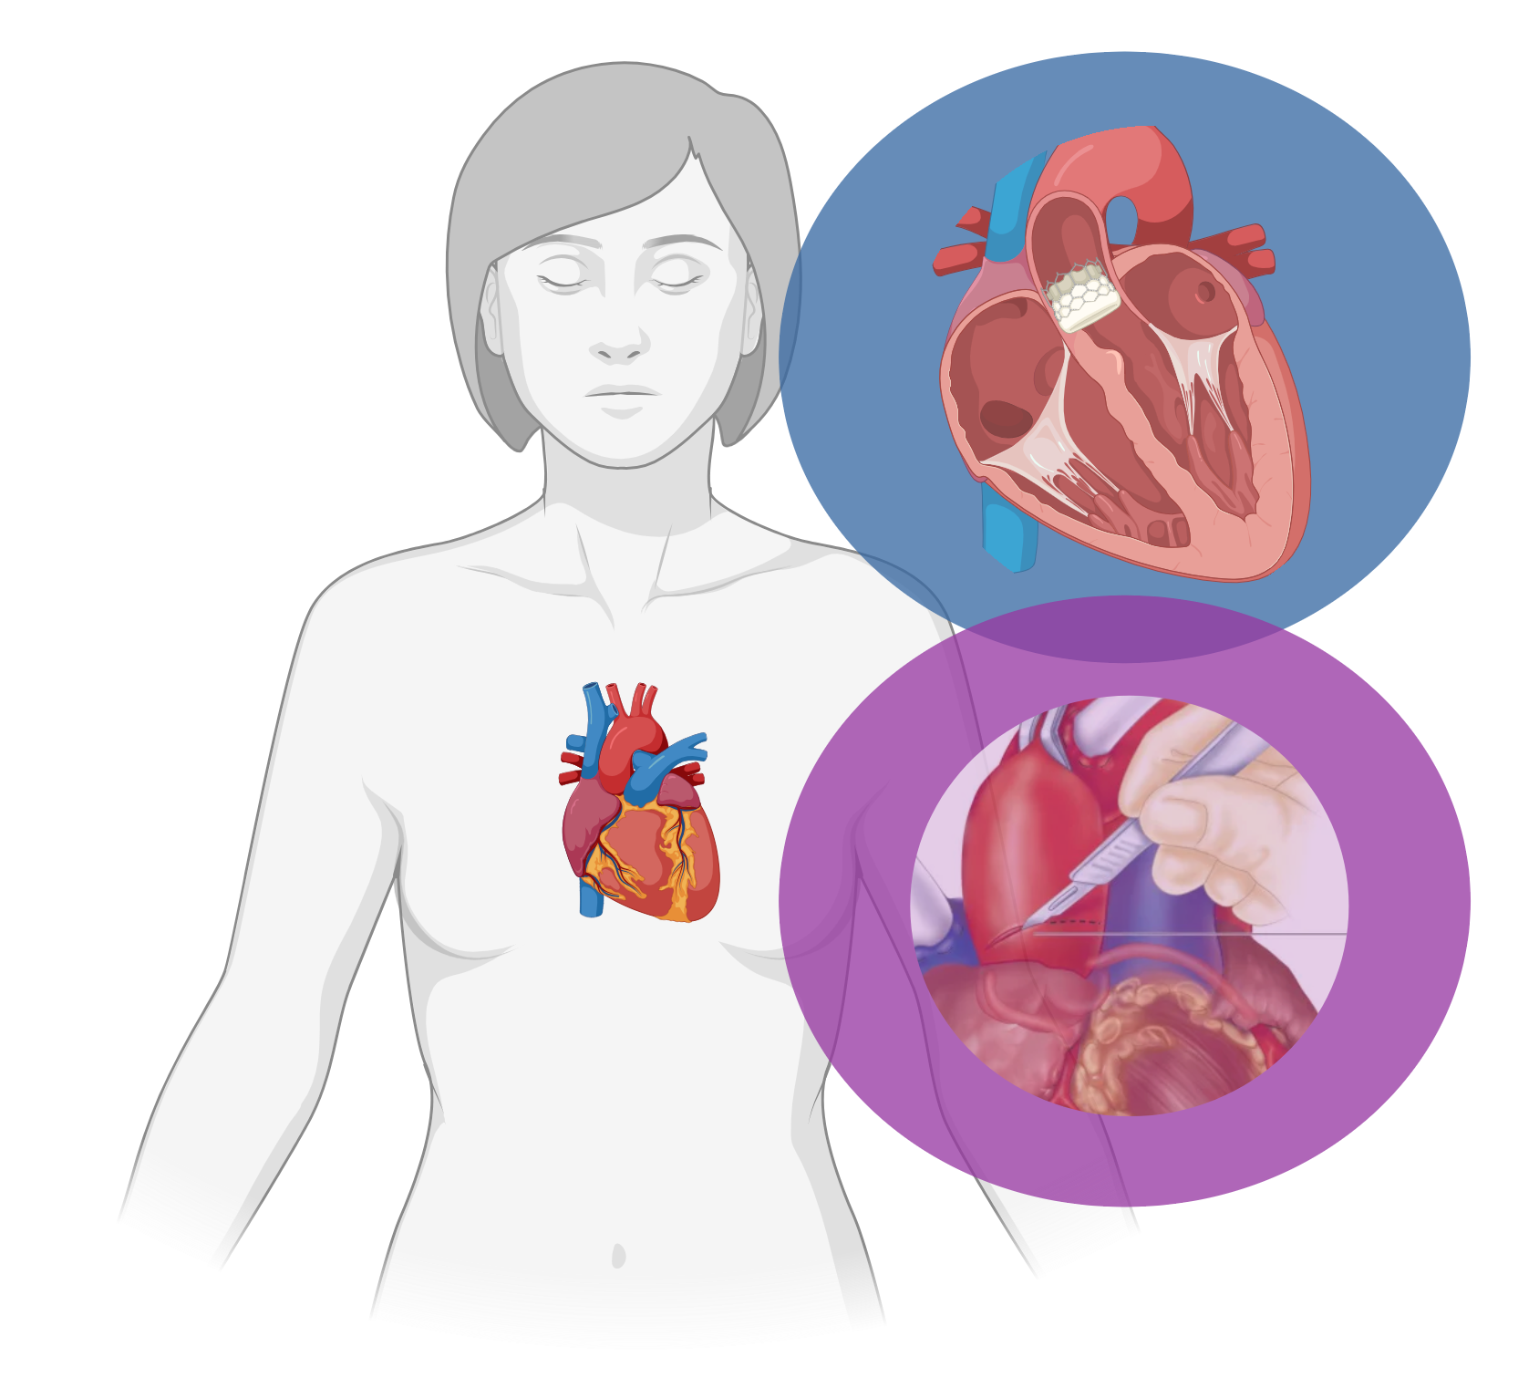

TAVI
TAVI in patients with
low surgical risk:
an expanding indication?
Low-risk patients
Surgery

Slide 2
EVOLUT Low Risk
PARTNER
3 Trial
DEDICATE
TAVI
4 years
5 years
1 year
9.0%
10.0%
2.6%
2.9%
2.9%
1.3%
12.1%
8.2%
6.2%
3.8%
2.7%
3.1%
Low-risk patients
Surgery
Death
Death
Death
Stroke*
Stroke*
Stroke*
*disabling stroke

Slide 3
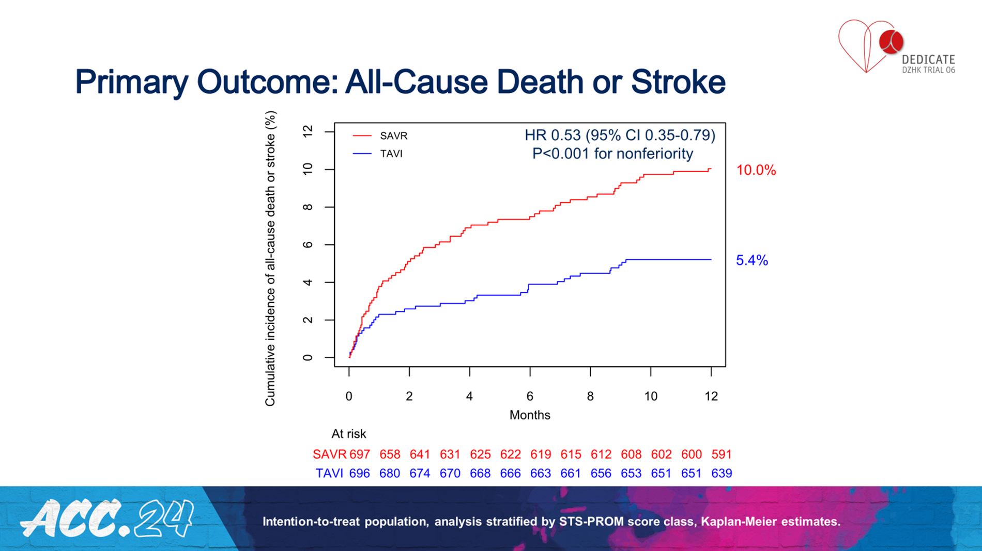
Surgery
TAVI

