Slide 1

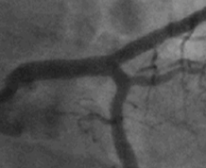
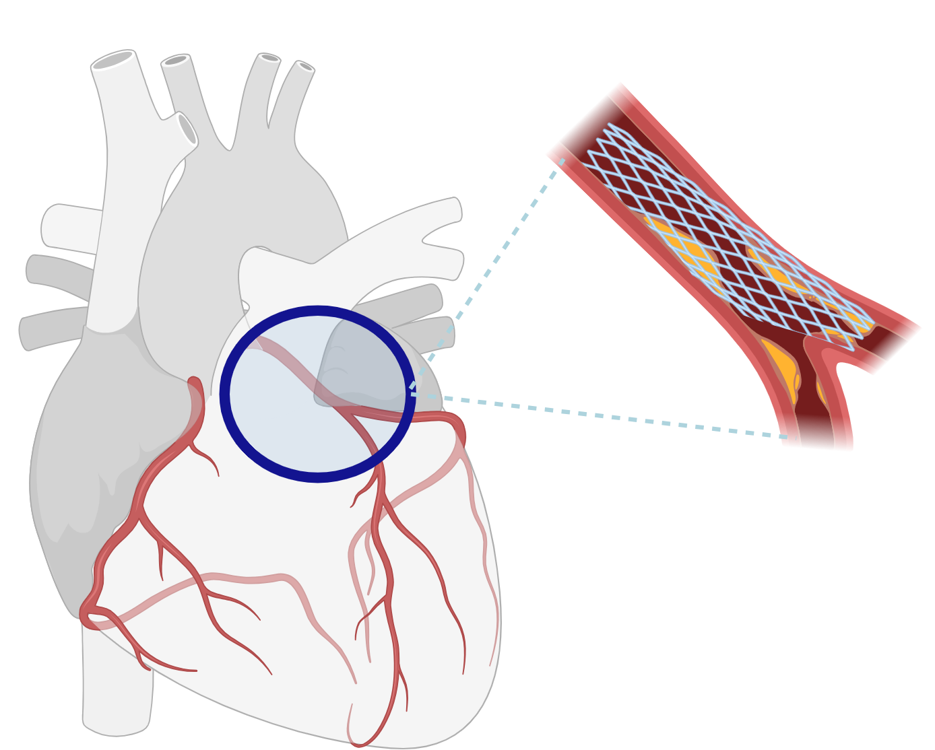
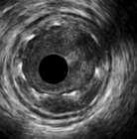
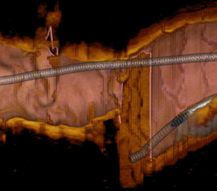
Angiography
Left main PCI with intracoronary imaging guidance: should it be routine?
Left main PCI
IVUS/OCT

Slide 2
Observational
Randomized
IVUS guidance
reduces mortality
MAIN COMPARE registry, 201 matched pairs
OCTOBER trial
(n=1201, 19% LM)
OCT guidance reduced composite MACE
2009
Patient-level pooled analysis, 505 matched pairs from Spain
Left main PCI
2014
OPTIMAL trial
(n=800, 100% LM)
IVUS vs. angiography
completed recruitment
UK national database,
11 264 patients*
Evidence base for IVUS/OCT guidance
2020
*<10% OCT 2012-2014

Slide 3
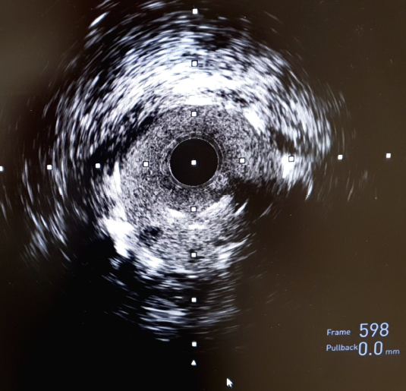
A practical approach to IVUS/OCT guidance for left main PCI
Well apposed stent struts on the left main vessel wall
Distorted stent struts in the left main lumen

Slide 4
A standardized approach to IVUS/OCT guidance for left main PCI
2
1
3
Having predefined IVUS-based optimization criteria is associated with improved outcomes
4
EuroIntervention. 2020 Jun 25;16(3):210-217.

